Slide 1

Karteset
Educational application for software development course
GitHub - https://github.com/Karteset-NLP-Coins/New-Karteset

Slide 2
Introduction
Karteset is an educational purposes application aimed to resolve the issues teachers and students are experiencing such as organizing study materials used by teachers and students alike, the miscommunications the schools are experiencing and to use modern tools to an outdated system.
In the market, we found the application Quizlettm which offers almost the same functionality but doesn’t support Hebrew, which is our main goal to expose this application to Hebrew speaking market.

Slide 3
Main goals
To organize study materials by subjects, each subject contains another divider, each divider contains study cards.
Let teachers share their notes, study materials, test subjects, homework and more in the easiest and fastest way possible.
Let the students receive the teacher’s notes, study materials, test subjects, homework and more in the easiest and fastest way possible.
Make students study more efficient.
Help students share their work with other students more efficiently.
Improve the study experience with modern tools.

Slide 4
Technologies
JavaScript
Expo
React
React Native
Firebase

Slide 5
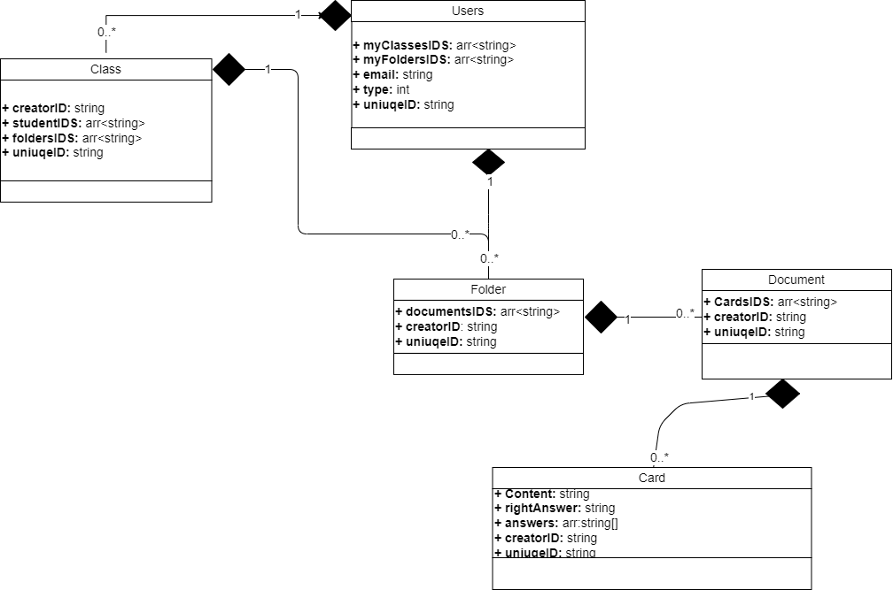
Class Diagram

Slide 6
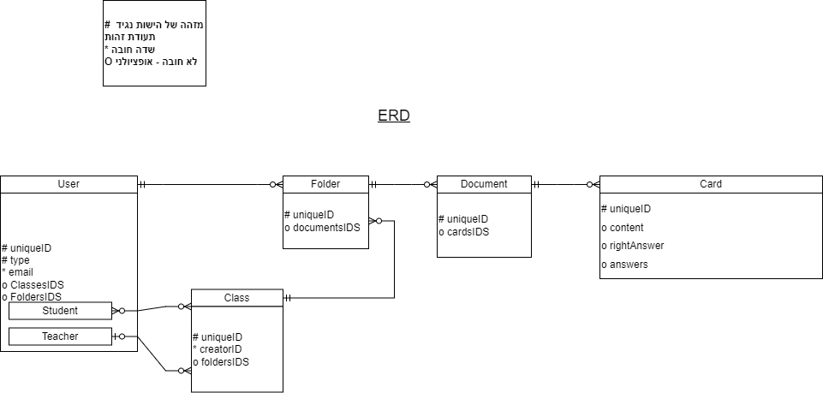
ERD Diagram

Slide 7
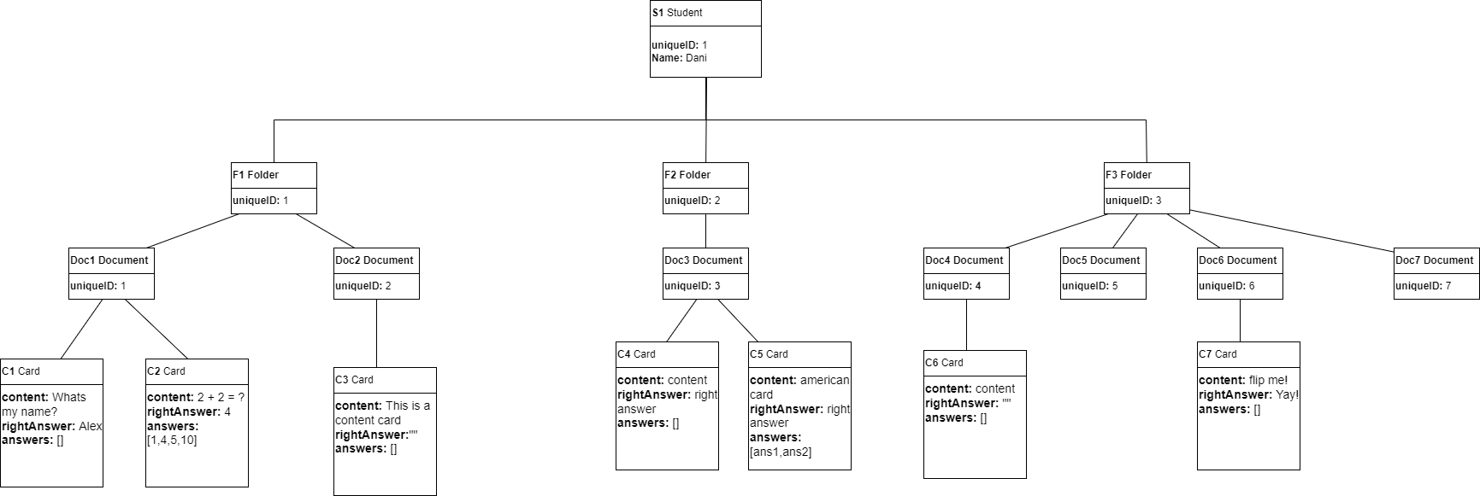
Object Diagram

Slide 8
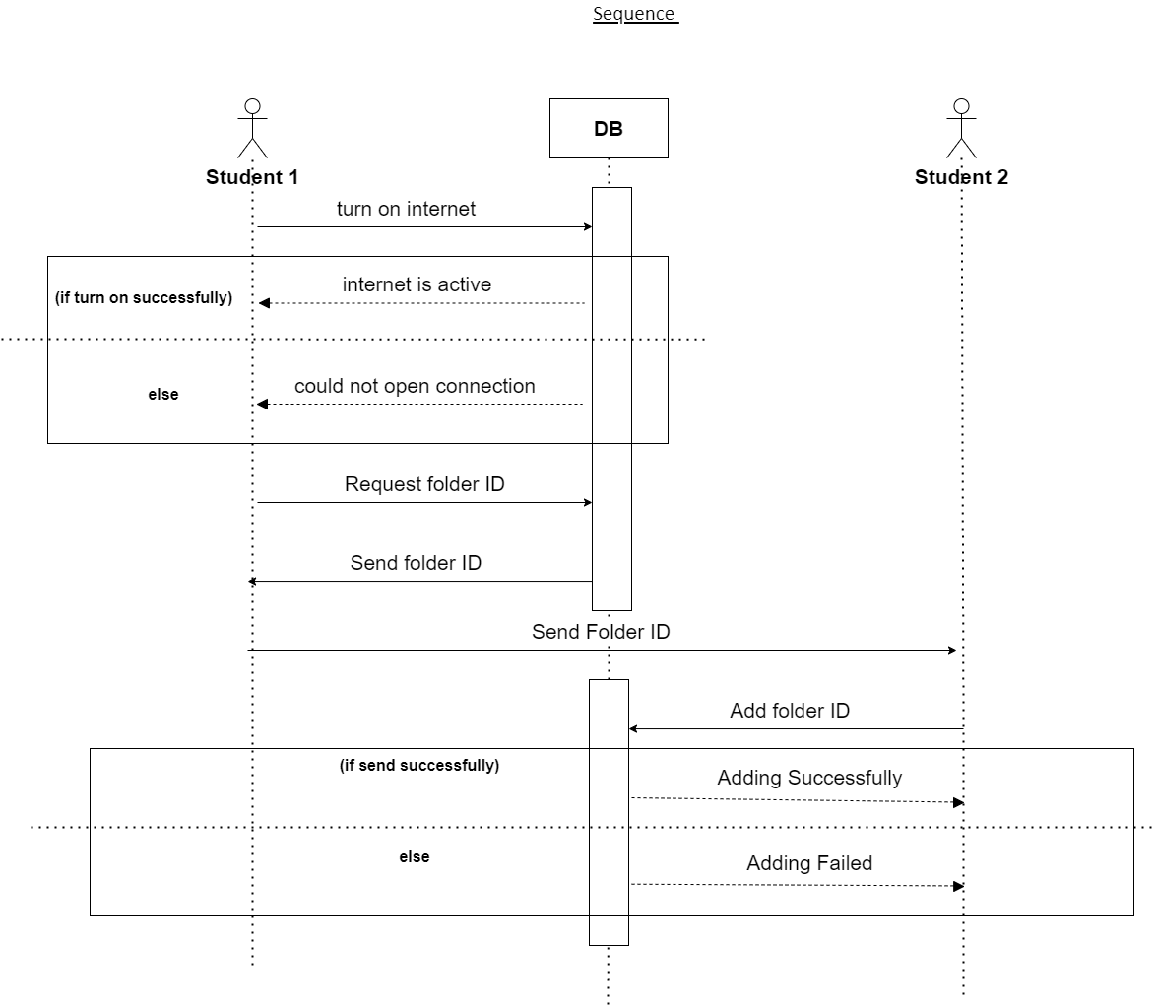
Sequence Diagram

Slide 9
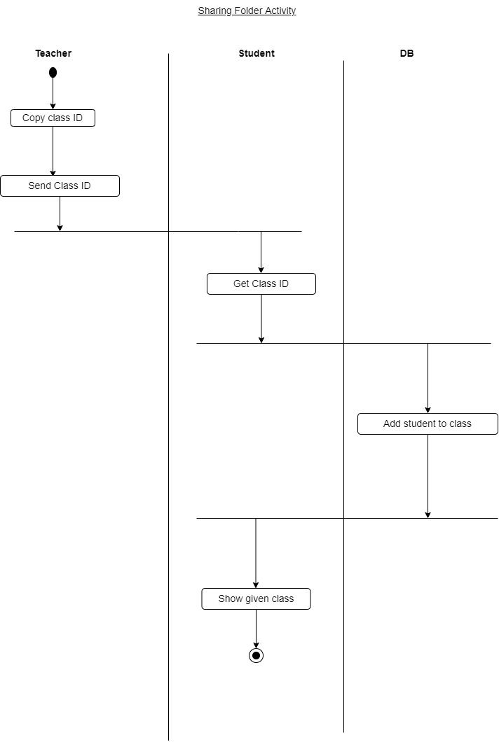
Activity Diagram

Slide 10
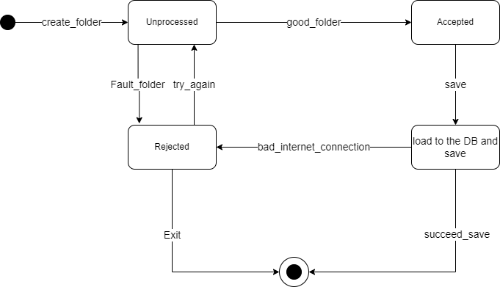
State Machine Diagram

Slide 11
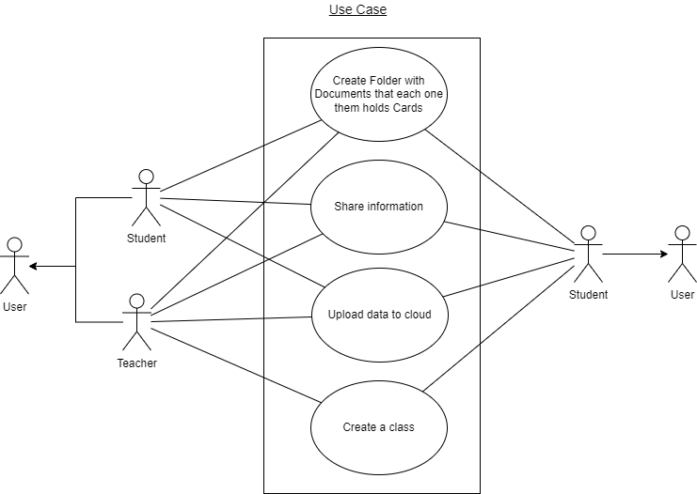
Use State Diagram

Slide 12
User types
Our application has two user types
Student – Is a free user with basic actions, including creating new folders and all its content and edit them, sharing folders, adding folders from other users, joining existing classes.
Teacher – Is a paid user having advanced actions, including the free user actions, on top of that, creating new classes, sharing classes and editing them and their contents.

Slide 13
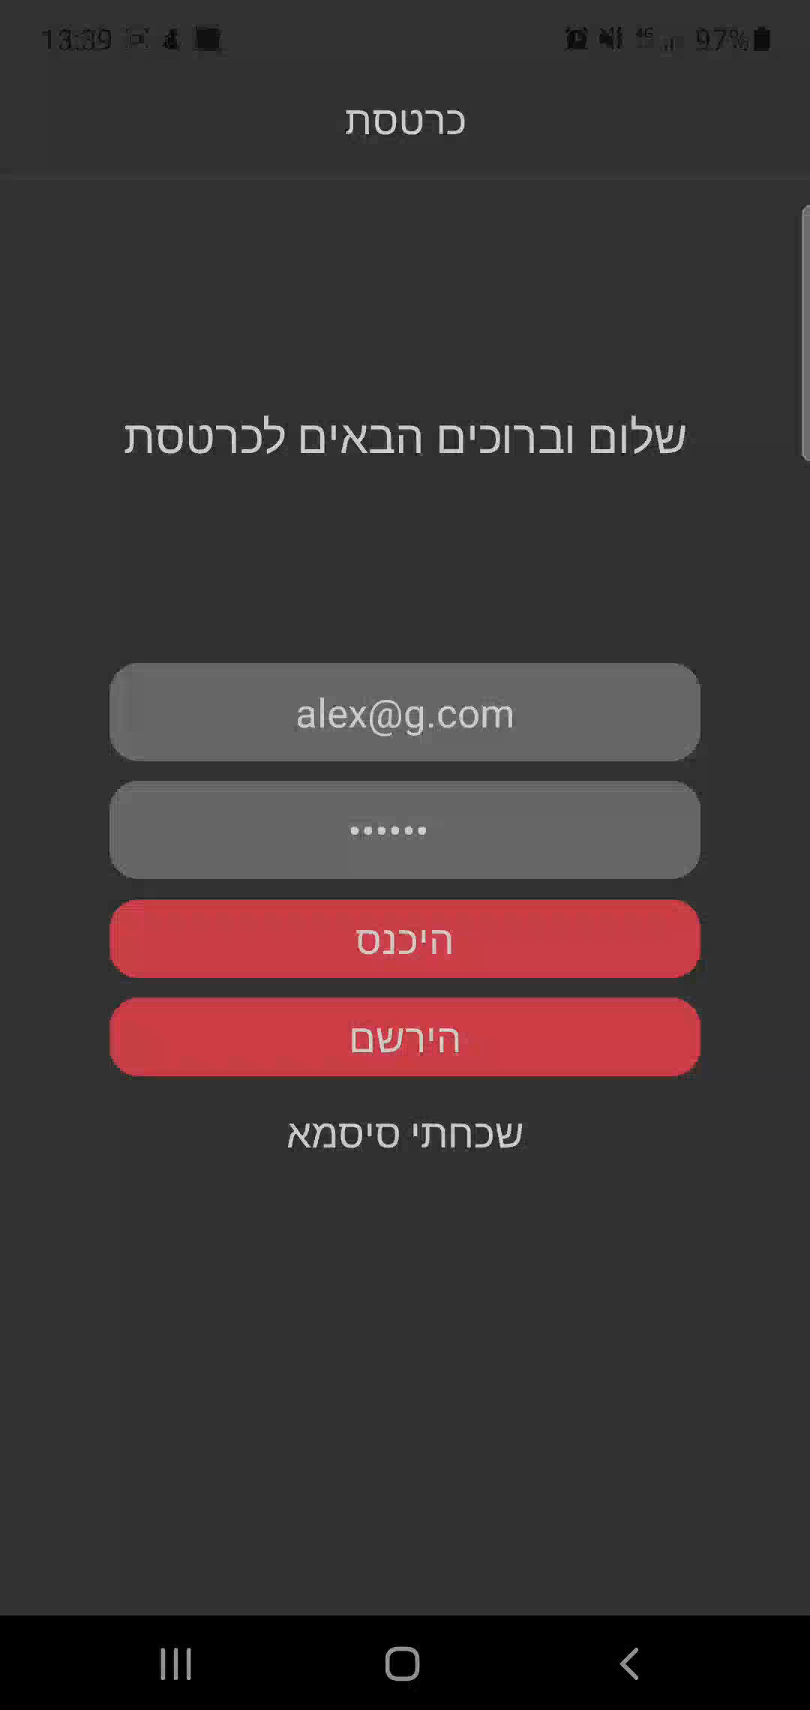
Demo of basic free user’s usage and teacher’s usage

Slide 14
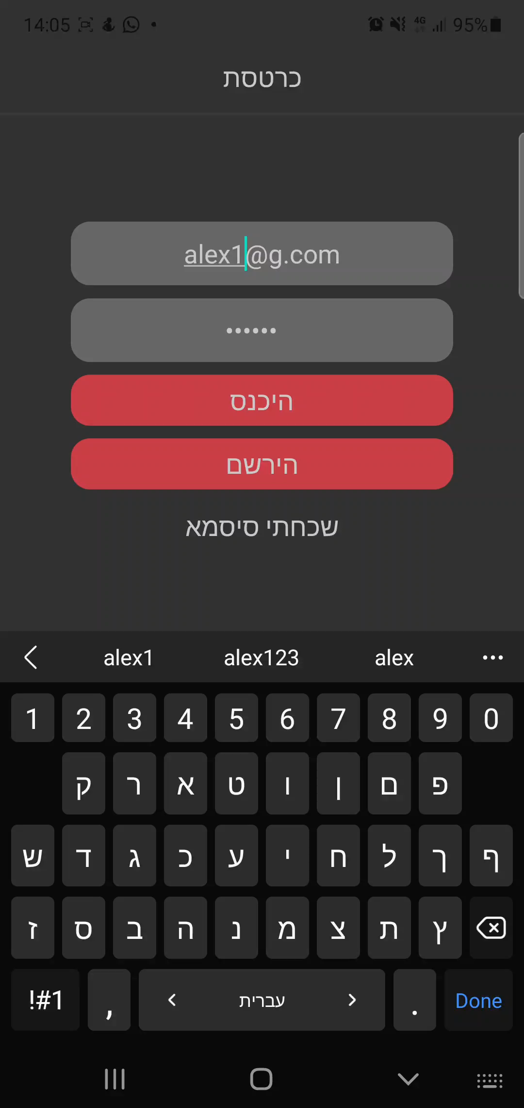
Demo of student’s view adding class

Slide 15
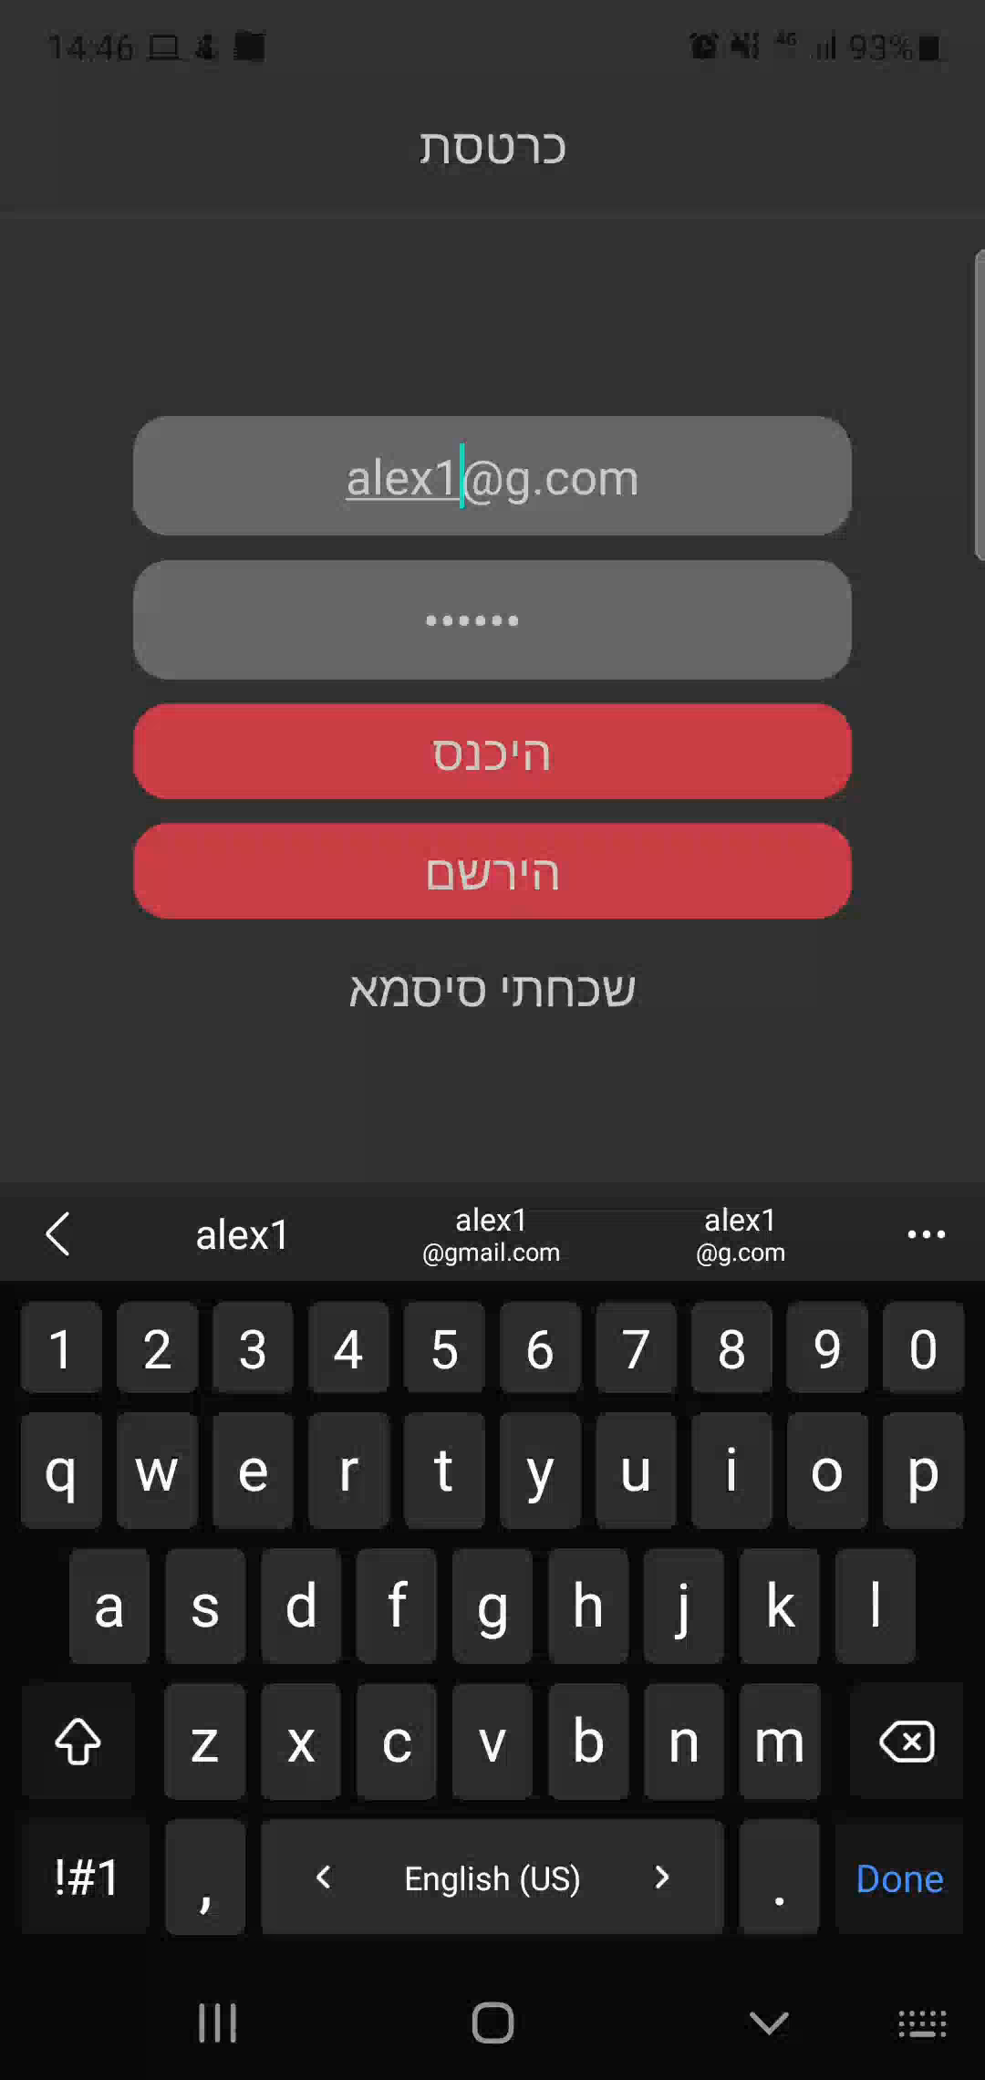
Demo of student’s view adding a folder

Slide 16
Gaps in our finished project
In our vision file we wanted to add the option to take a test. Taking a test is basically running an un-editable screen which is the test, with swipes to the left or to the right to get the next or previous card. Another gap from our vision file is the option to save the user data locally. We haven’t implemented those options because our time was running out and we needed to make hard decisions, but we did in the progress added much more features to the application.

Slide 17
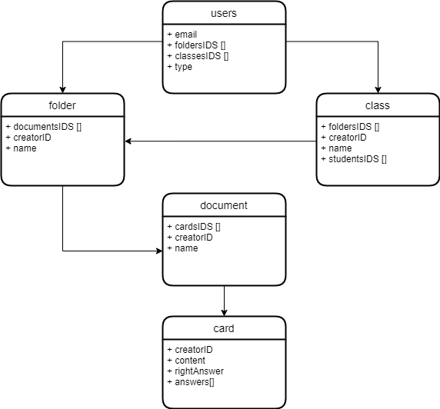
Data Base Structure

Slide 18
Conclusions
Working as a team on a single large project was exiting and educational experience for us.
We achieved most of the visions of our project and we are happy with the outcome we made.
We learned a lot about the technologies we used and the way to organize and lead a project.

